Slide 1


STATUS QUO
Campus Connect
by Ali Ayhan Güner and Kaan Yusuf Çotuk

Slide 2

INDUSTRY/SPACE
Due to the designed duality of our project, it can target two industries that centers university students:
E-commerce:
Localized and specific needs of the students (such as lecture notes, scientific calculators, or books) can open C2C and B2C marketplace opportunities.
Online Buddy:
Events and regular entertaining activities of university students engages social interactions. There is

Slide 3
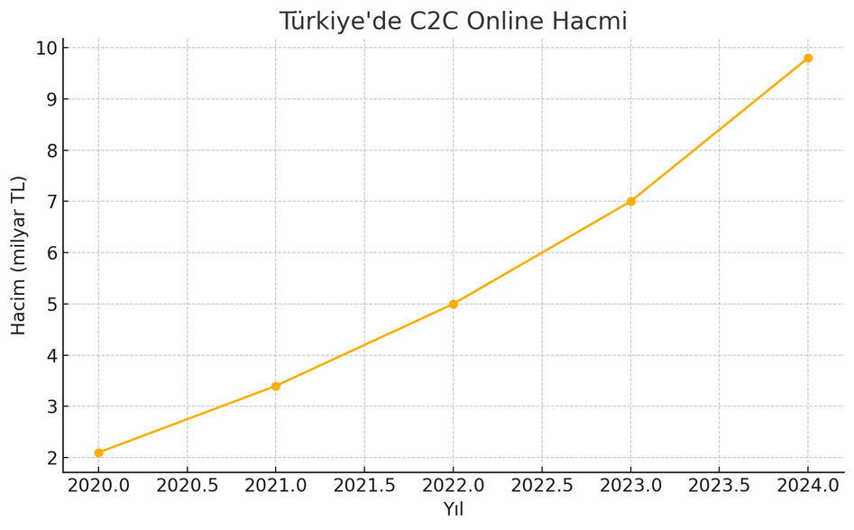
C2C TREND IN TÜRKİYE
C2C online trade volume in Türkiye reached 9.8 billion TL by 2024, as a result of COVID-19 pandemic.
The number of C2C online transaction reach 17.5 million by 2024.
“Türkiye’de E-Ticaretin Görünümü”, Ministry of Trade, 2025

Slide 4
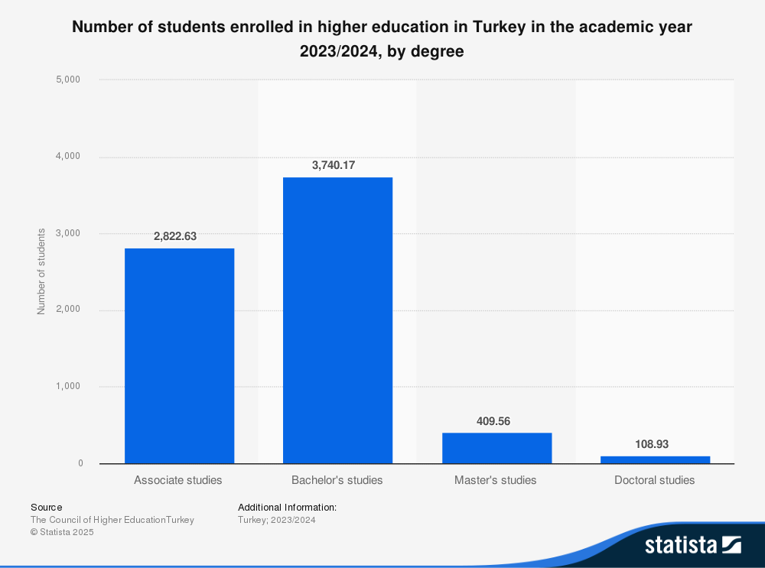
Student Population
7.08 million students enrolled in Turkish higher education (2022-2023), with over 3.7 million bachelor's degree students
209 universities across Turkey

Slide 5
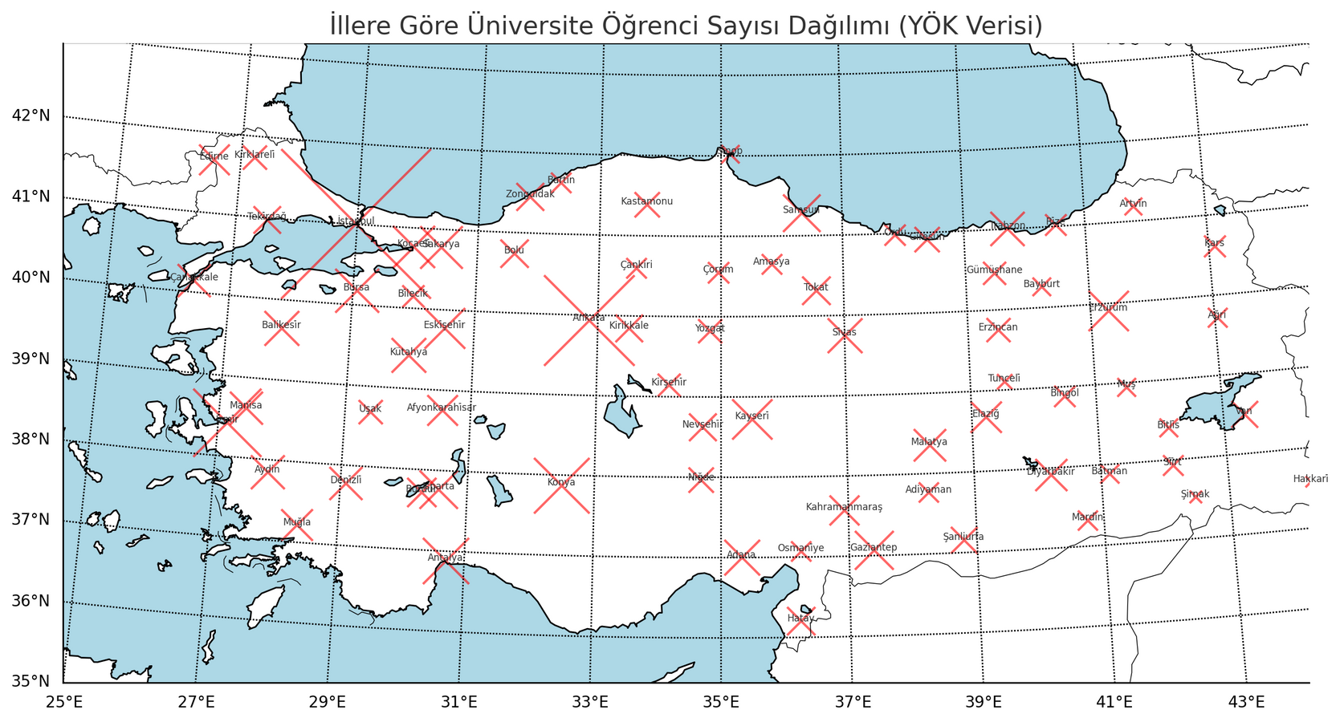
DISTRIBUTION OF UNIVERSITY STUDENTS IN TÜRKIYE BY 2024-25

Slide 6
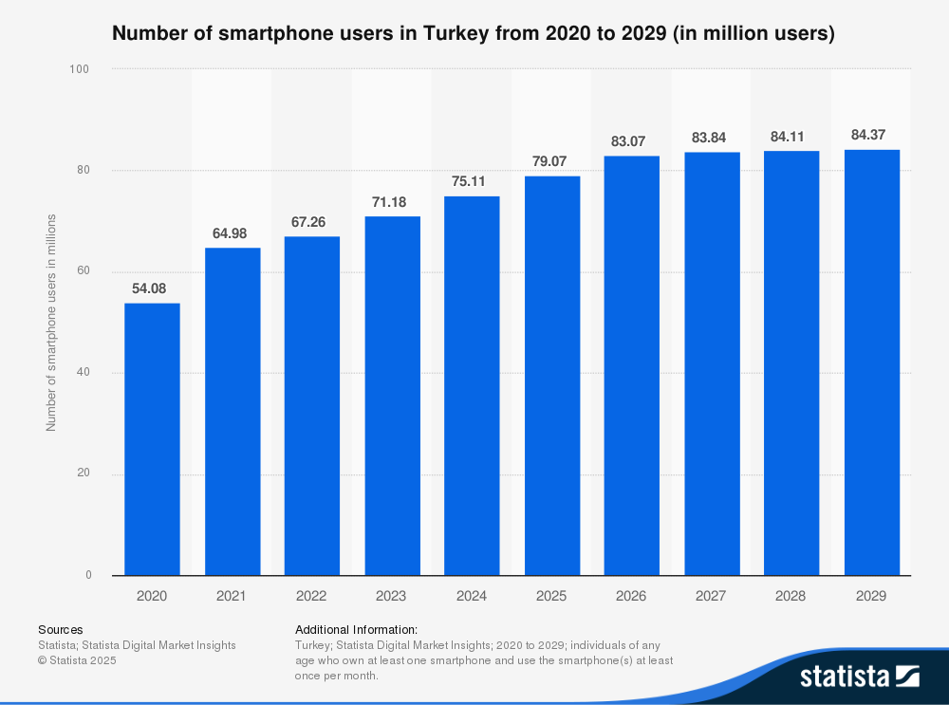
Digital Adoption
80.69 million cellular mobile connections in Turkey.
Smartphone users projected to reach 84.07 million by 2029 (+13.5% growth).
15-24 age group shows highest e-commerce adoption rates.

Slide 7
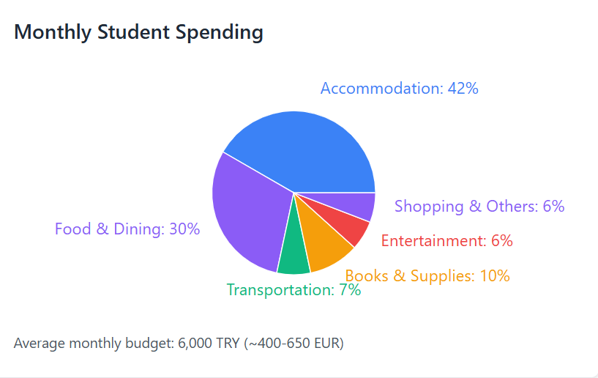
Student Spending & Economic Data
Monthly Budget Breakdown :
International students live with 400-650 EUR per month budget
Average living cost in Istanbul: ~$1,700 per month (excluding rent)
Turkish household average: 24,383 TRY per month per household, 12,521 TRY per individual
Student spending range: 4,724-11,811 TRY monthly excluding rent

Slide 8
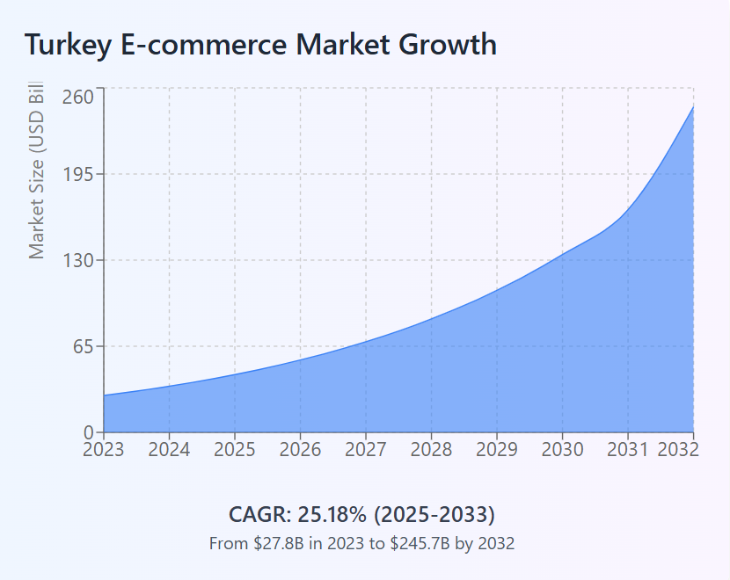
E-commerce Growth
Turkey E-commerce market growing at 25.18% CAGR (2025-2033)
Alternative projection: 22.6% CAGR over next 5 years
Market size reached USD 27.8 billion in 2023, projected to hit USD 245.71 billion by 2032
Major players: Amazon, Trendyol, Sahibinden.com, Hepsiburada, n11

Slide 9
COMMISSIONS AND CARGO FEE
Dolap, one of the most significant competitor in C2C e-commerce market, applies the policy of commissions (%15 from the seller, and %8 from the buyer). Also, there are several complaints about overcharging the cargo fee.
Commissions and cargo fees are standard source of income for such platforms.
By advantage of localization and trusted common places, cargo fees may be reduced. Also, for the start, commissions may be replaced with ads.

Slide 10
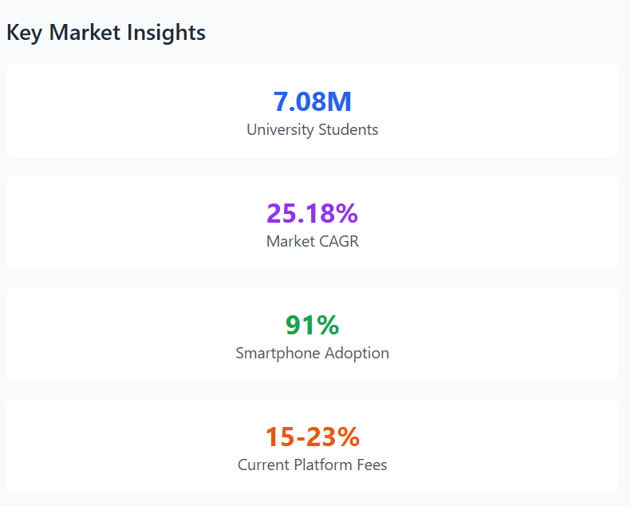
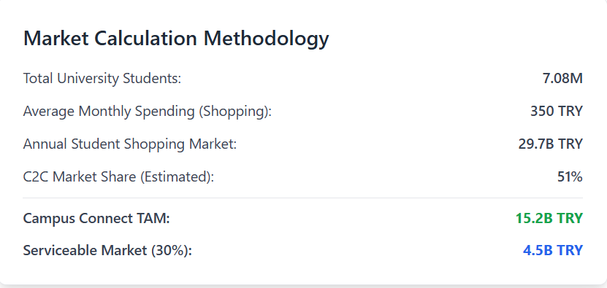

Slide 11
POWER OF HOMOPHILY
Homophily, a sociological concept, describes how people are naturally drawn to those similar to themselves—whether by beliefs, values, demographics, or preferences. This natural affinity fosters trust and smoother interactions.
Universities can be a package for these elements!
Especially in well established universities, students are connected with, not only on the same location, but also on the same cultural ground.

Slide 12
STATUS QUO SENTENCES
STUDENTS AND E-COMMERCE IN TÜRKİYE GREW TOGETHER.
Turkey's 7.08 million university students, spending 400-650 EUR monthly with 91% smartphone adoption, represent an underserved segment in the rapidly growing e-commerce market (25.18% CAGR) dominated by generic platforms charging 15-23% commissions.

Slide 13
REFERENCES
Ministry of Trade, Republic of Turkey (2025). Türkiye'de E-Ticaretin Görünümü [Overview of E-commerce in Turkey]. Ministry of Trade Official Report.
YÖK (Council of Higher Education) (2023). Higher Education Statistics 2022-2023. Retrieved from YÖK İstatistik Database.
Turkish Statistical Institute (TÜİK) (2023). Household Consumption Expenditure Statistics. Official Government Statistics.
Statista (2024). Turkey E-commerce Market Analysis 2024-2032. Market Research Report.
Research and Markets (2024). Turkey E-commerce Market Report - Growth, Trends, and Forecasts (2024-2029). Market Intelligence Report.
Numbeo (2024). Cost of Living in Turkey - Monthly Expenses Breakdown. Living Cost Database.
Trendyol, Hepsiburada, n11 (2024). Market Share and Platform Analysis. Competitive Intelligence Report.
Dolap (2024). Commission Structure and Fee Policy. Platform Official Documentation.
Sahibinden.com (2024). C2C Marketplace Statistics and User Behavior. Platform Analytics Report
Journal of Business Research (2023). "Homophily and Trust in Online Marketplaces: Evidence from University Communities". Academic Research Paper.
GSMA Intelligence (2024). Mobile Connectivity Index: Turkey 2024. Mobile Industry Report.
Sensor Tower (2024). E-commerce App Downloads and Usage in Turkey. Mobile App Intelligence.
OECD (2024). Turkey Economic Outlook - Digital Commerce Sector Analysis. International Economic Report.

Slide 14
THANK YOU
FOR LISTENING

